Slide 1

Flexible Time Sensitive Network (Flex-TSN) for Autonomous Systems
Speaker: Jie(Joey) Zou
Supervisors: Dr. Wanli Chang
Prof. John McDermid
12 Nov 2020

Slide 2
CONTENTS
Background
Research Problems
Flexible TSN
Key Techniques
Network Simulation
Conclusion

Slide 3
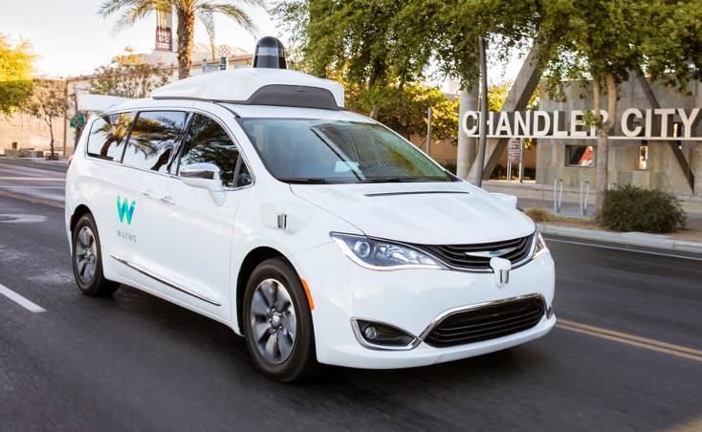
Background
Autonomous Vehicle
Sensing, understanding its environment and operating without human involvement.
In Level 5 driverless car, the human driver is not required at any time.
Go anywhere a traditional car goes and perform better than an experienced human driver.
Short-Range Radar
Long-Range Radar
David Rose. The four pillars of self-driving cars, 2018. 5, 6
https://innovation-destination.com/2018/02/16/7-factors-critical-success-self-driving-cars/

Slide 4
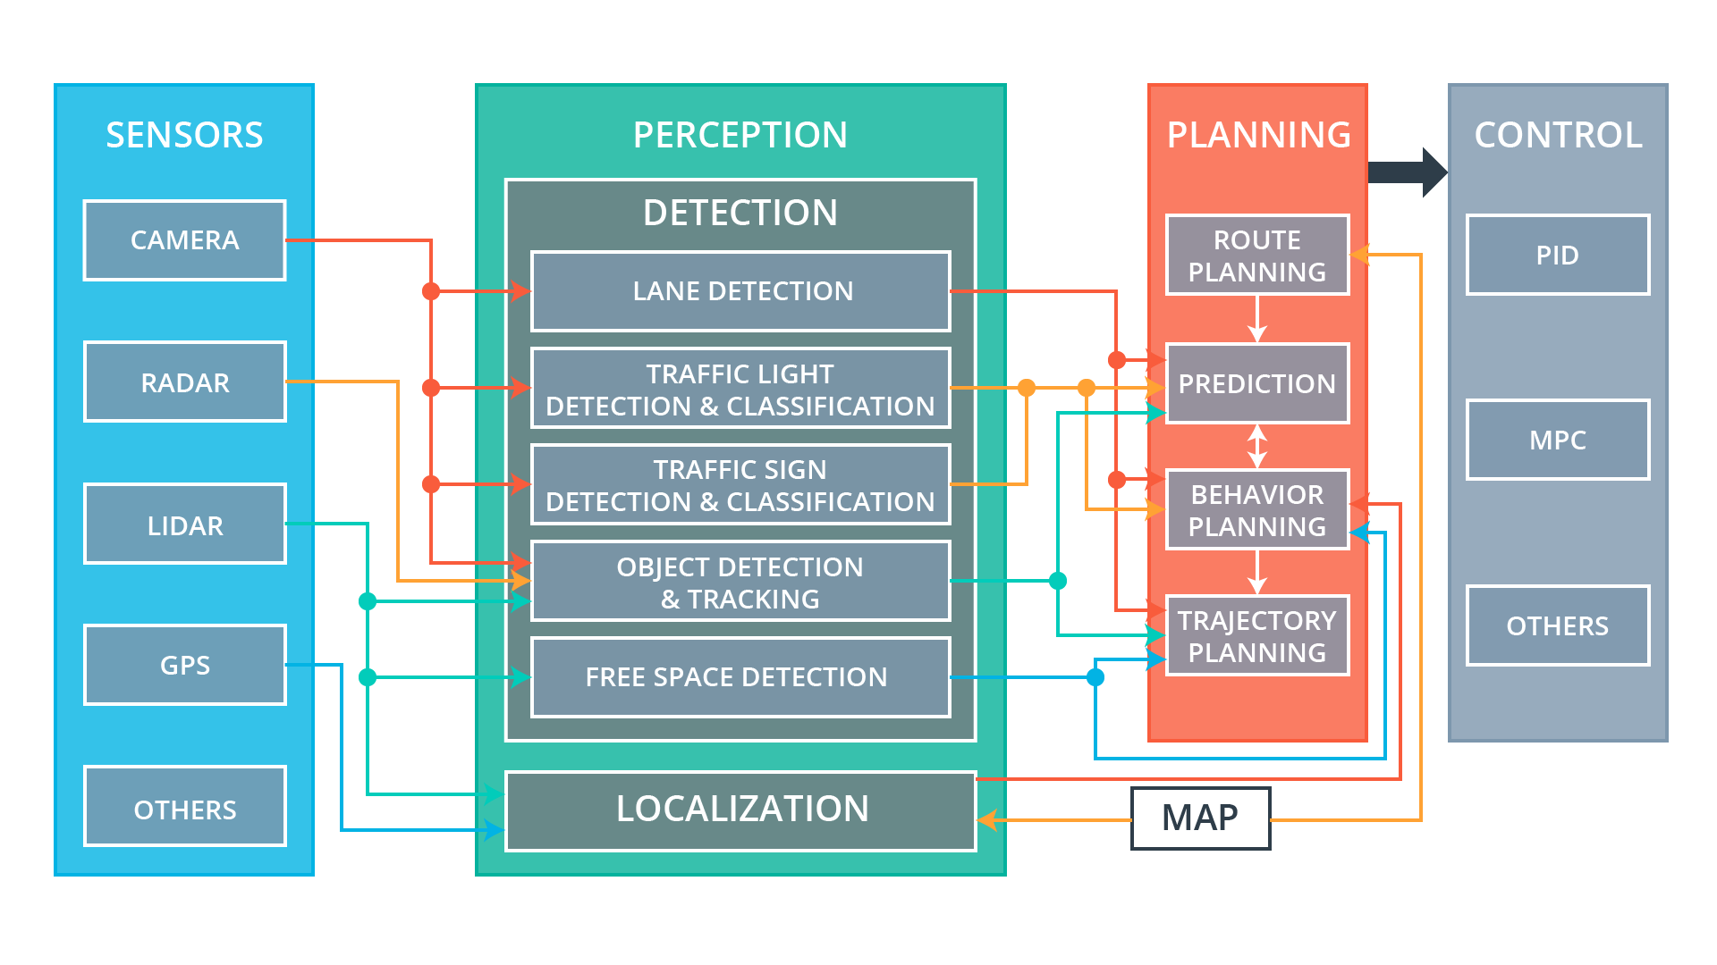
Background
Autonomous Vehicle from REAL-TIME SYSTEM’s point of view
Real-time systems are designed for predictability to ensure that safety-critical tasks are carried out within a maximum allowable amount of real-time. They must be scheduled when to executed to ensure time constraints are met.
For autonomous vehicle:
It is Implemented as distributed systems, connecting various sensors, actuators and nodes. It is important to determine end-to-end delay from the point the event has been sensed to the point the system is ready to react to the event.
Safety-critical tasks must be executed， and output results within a specific time (deadline requirement).
E.g. Pedestrian detection --> Emergency braking decision --> Brake control.
Safety-critical data flows must be transmitted with the lowest end-to-end delay (latency requirement).
E.g. High-resolution camera images, High-density Lidar point clouds, control data.
David Rose. The four pillars of self-driving cars, 2018. 5, 6

Slide 5
Background
Safety and reliability challenges
Functional
How accurate and reliable the algorithms can be?
Are existing integrated solutions safe enough to deal with the real driving environment?
…
Timing problem (non-functional)
Missing time constraints in a real-time system can be hazardous, from the degradation of service to fatal system failure. Time-constraints in real-time systems can be divided into three categories based on the consequences of a missed deadline: hard, soft or firm:
Hard real-time constraint: Deadline missing would lead to non-tolerable and catastrophic consequences, typically used for periodic tasks. E.g. Vehicle control.
Soft real-time constraints: Occasional deadline misses are tolerable with an upper time limit. E.g. Some warning event may have a soft deadline of 50ms for an optimally efficient reaction and a hard deadline of 200ms to avoid damage.
Firm real-time constraint: Missing a deadline is tolerable. E.g. Entertainment system.

Slide 6
Background
The sources of timing issues:
Sampling and transmission:
The velocity of the sensor data can be fed into the process engine is not only defined by the sampling time but also involves the time for the data transmission in the communication network. The uncertainty can be caused by:
Sampling jitter --> the release time jitter --> response time jitter --> traffic flow interference
Traffics transmission simultaneously --> traffic overload --> congestion and deadline missing
Network delay and delay variation (jitter) in real-time communication must be deterministically bounded.
Tasks execution:
The processing time can determine how fast the system react to the captures sensor data. The latency involves the instruction execution time and the memories accessing time (not expand here).

Slide 7
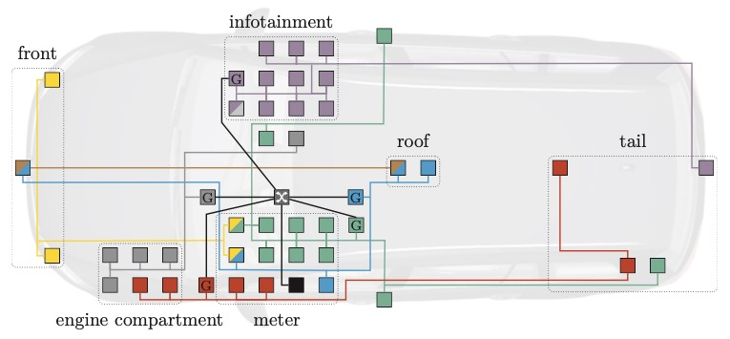
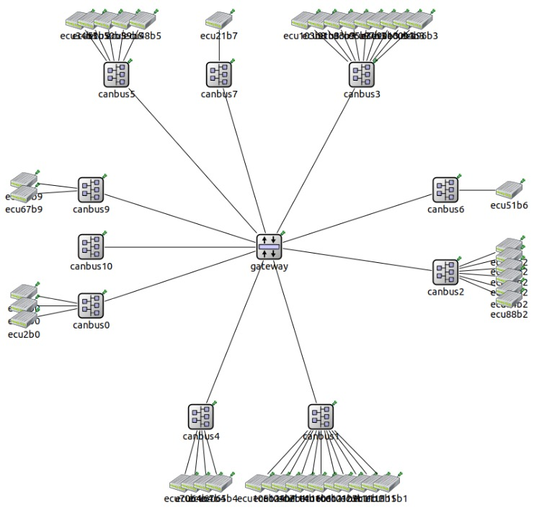
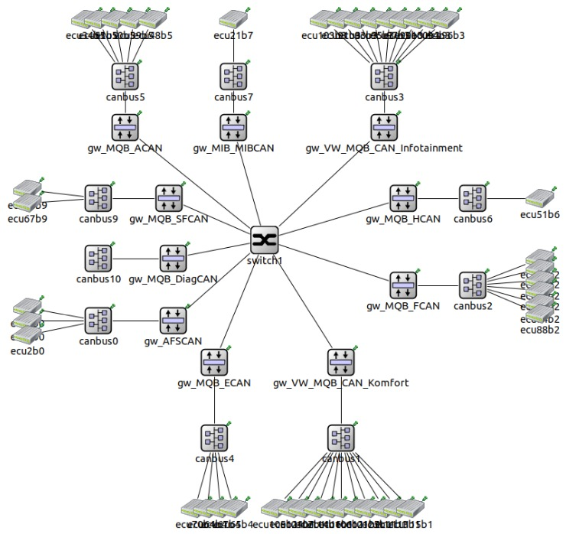
Background
Focus on In-Vehicle communication network
Communication architectures of vehicles are composed of different domain- specific technologies. Cross-domain communication is enabled via a central gateway.
Fig.1: Traditional car: pure CAN (Controller Area Network) based network
Fig.2: Advanced car: As part of the migration to a pure Ethernet-based
communication layer, gateways will connect CAN buses to the Ethernet
backbone.
Domain Decomposition of a In-Vehicle Network
Disadvantage of CAN:
The bandwidth of CAN is 0.5 Mbit/s. Concerning this growing heterogeneity, current automotive communication architectures and technologies reach their limits.
For example, a low-resolution camera stream of 7 Mbit/s already exceeds CAN’s 0.5 Mbit/s 14 times.
Advantage of Ethernet:
Ethernet has a considerable bandwidth 1 Gbit/s or even more.
Fig.1
Fig.2

Slide 8
Background
Why Switched Ethernet ?
Conventional Ethernet networks operate by broadcasting the message from a source node to all connected nodes in the network, with no regard of destination. This means that only one node can transmit messages at any given time. Switched Ethernet addresses this issue by only sending traffic from sources to its destinations. This allows Ethernet switches to have multiple concurrent transmissions in the network, greatly increasing switches efficiency. As the Ethernet switch can control the flows on the network, end-to-end delays throughout networks can be bounded.
Why real-time Ethernet?
Automotive communication consists of a collection of distinct services that strictly difference in quality, and potentially interfere within a flat common network. Standard switched Ethernet must be extended beyond simple traffic prioritization to provide real-time guarantees. Lack of deterministic behaviour leads to unpredictability in the communication system. Therefore, real-time Ethernet solutions special transport protocols focused on delivering low latency, and deterministic typically introduce delay guarantee.

Slide 9
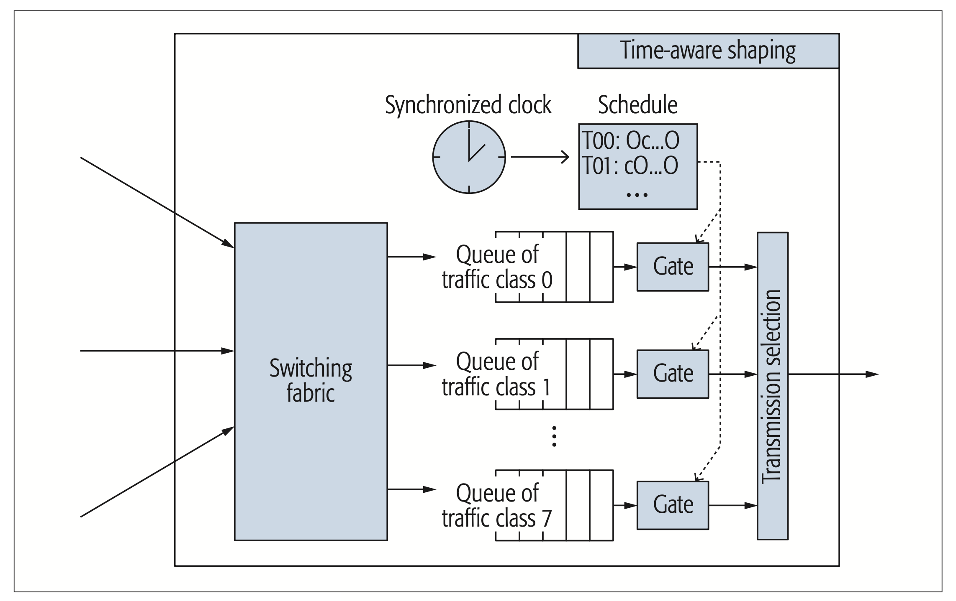
Background
Why Time Sensitive Networking (TSN) ?
Some examples of the real-time communication standards based on Ethernet have been proposed. However, they are incompatible with other networking technologies. Solving this issue is one of the goals of the TSN standard.
These standards will enable converged networks transporting the whole range of traffic classes—from best-effort (non-critical with low priority) to deterministic (Time-critical with high priority) real-time traffic—with single network technology.
The transmission of TSN flow is based on a time schedule to guarantee the time predictability. The IEEE 802.1AS-rev standard specifies the protocol for establishing and maintaining time synchronization between network devices. And also ensure the time schedule is followed correctly throughout the network.
As mentioned before, the traffic classes of the autonomous system are different and can be encoded in the data link frame with a three-bit priority code point (PCP). Each TSN switch can queue up to eight different traffic classes with different priorities on every port.
Wilfried Steiner, Silviu S Craciunas, and Ramon Serna Oliver. Traffic planning for time-sensitive communication. IEEE Communications Standards Magazine, 2(2):42– 47, 2018. 11, 12

Slide 10
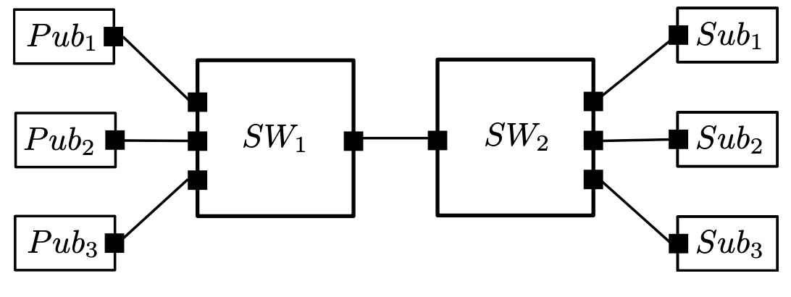
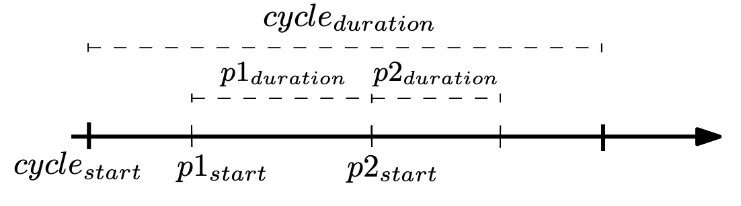
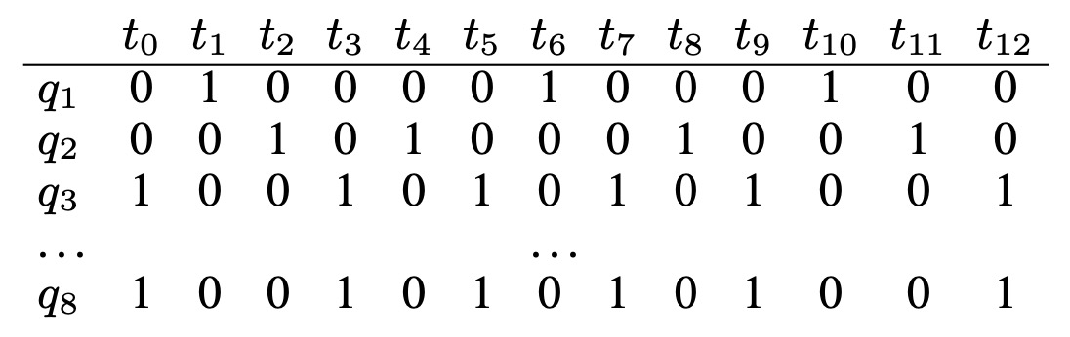
Background
The IEEE 802.1Qbv standard defines scheduling mechanisms. The Time-Aware Shaper (TAS) determine when different traffic classes should be allowed to transmit on a network. TAS schedules consist of equal discrete time-slots. Each slot specifies which gate should be open or closed at that specific time to ensure determinism and real-time. The schedule can be represented as a list, called Gate Control List (GCL), which contains the time-slot entries and the associated configuration of gate states (GS).
TSN scheduling problem can be described as an SMT (satisfiability modulo theories ) problem which is solved using the Z3 SMT solver
Network topology with Publishers (Pub) and Subscribers (Sub) connected via a single link (SW1 to SW2)
Fig.1
IEEE802.1Qbv schedule for the port that connects SW1 to SW2
Example of GCL( gate control list): 0 Gate close, 1 Gate open
Gate for flow2 close
Gate for flow1 open
Gate for flow1 close
Gate for flow2 open
Flow1 is mapped to priority p1, Flow2 is mapped to priority p2 and the rest of the cycle is open for transmitting other traffic.
Fig.2

Slide 11
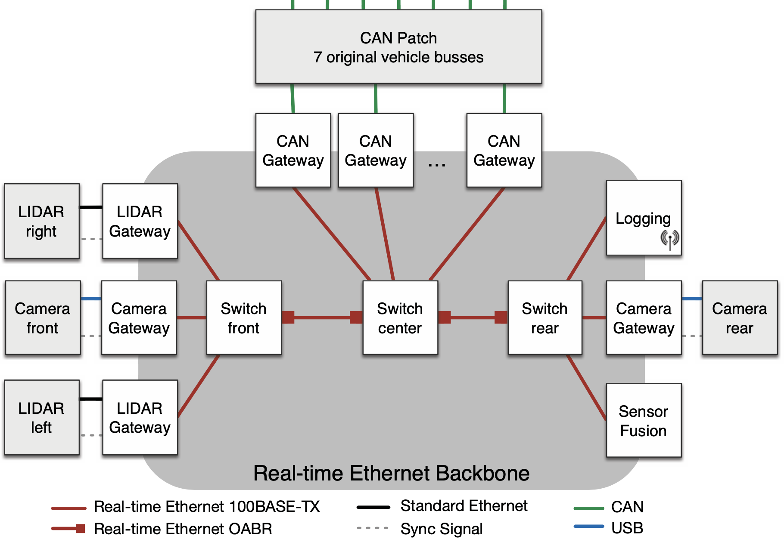
Background
Architecture of autonomous driving in-vehicle network
TSN based in-Vehicle network is operating on an offline configured schedule with dedicated transmission slots for all real-time messages shared among all network participants.
Schedule enables a coordinated time-division-multiple-access (TDMA) media access strategy with the deterministic transmission, predictable delays. And prevents congestion on outgoing line cards and thereby enables isochronous communication with low latency and jitter.
…
Meyer, Philipp, et al. "Simulation of mixed critical in-vehicular networks." Recent Advances in Network Simulation. Springer, Cham, 2019. 317-345.

Slide 12
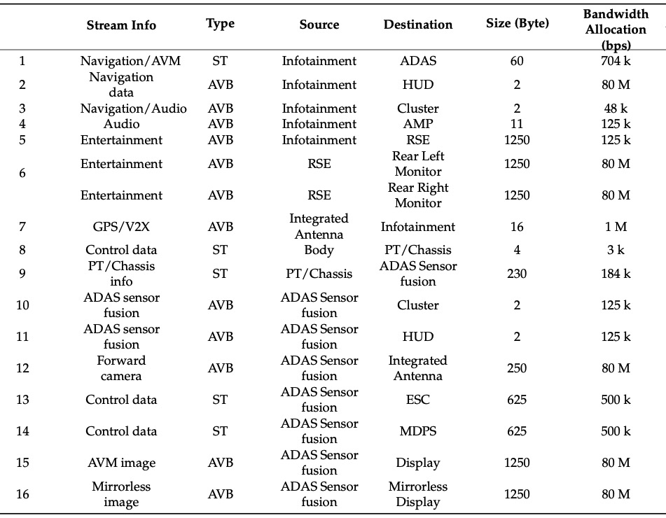
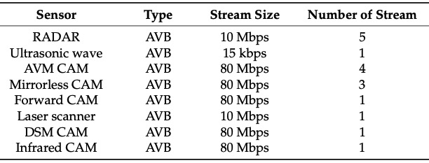
Example
Streams for autonomous driving
ST : safety critical traffics with the highest priority
AVB: Audio/Video Bridging
non-safety critical traffics with relative lower priorities
Note:
In an autonomous driving system, the type may be changed. Traffics from Radar, Lidar and some cameras can be ST.
Streams for advanced
driving assistant system (ADAS) sensor fusion
AVM: around view monitoring
DSM: driver status monitoring
Lee, Juho, and Sungkwon Park. "Time-sensitive network (TSN) experiment in sensor-based integrated environment for autonomous driving." Sensors 19.5 (2019): 1111.

Slide 13
Research Problems
Gate Control List (GCL) for TSN can assist in realizing time isolation to avoid interference between different frames. It is calculated offline and fixed during runtime.
Unexpected aperiodic and sporadic data flow may lead to traffic overload. For extensive network, online schedule calculation may be unpractical. How to deal with the unexpected traffic in the network to make the system flexible and robust?

Slide 14
Research Problems
External events (e.g. an emergency event) may trigger some unexpected data flows lead to overload, the release time of related flows is unknown before they are triggered.
Sporadic packet: with hard real-time requirement ---> emergency brake related sensor data and control traffics
Aperiodic packet: with soft real-time requirement ---> Deceleration process related sensor data and control traffics
Purpose of current work:
Improve scheduling flexibility of TSN switches when adding unexpected flows into the network
Transmission of sporadic packets without causing periodic and previously accepted sporadic packets to miss their deadlines.
Transmission of aperiodic packets as soon as possible without causing periodic and accepted sporadic packets to miss their deadlines.
Evaluation:
the actual number of received sporadic/aperiodic packets;
the min, max and average end-to-end delays of each flow.

Slide 15
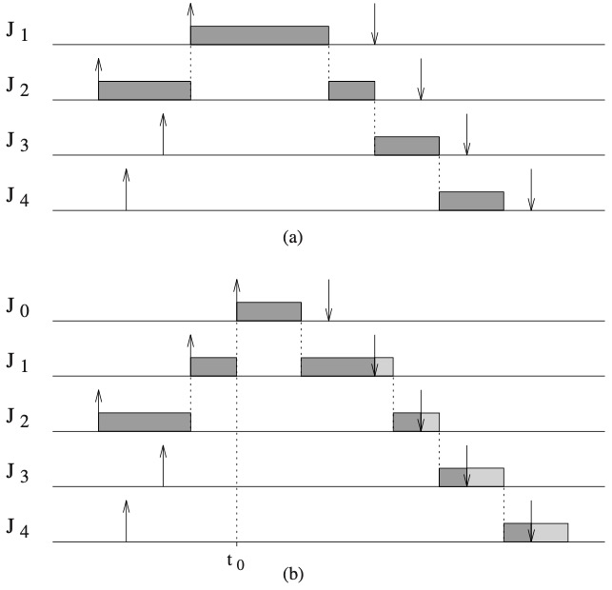
Example of overload
If the operating system is not designed to cope with excessive flow arrivals, the effects of an overload can be unpredictable and cause severe problems for the system.
(a) shows a feasible transmission schedule of a set of flows.
(b) shows if at time t0 flow J0 is transmitted because of higher priority, all the previous transmitted traffics will miss their deadlines.

Slide 16
Flexible TSN
Proposed solution：
The sporadic flows are handled by bandwidth preserving server and treated as periodic flows. The GCL is calculated only based on periodic flows in the system.
For sporadic and aperiodic flows, the packets can be queued only if the acceptance test passed.
At scheduling decision times, slack is calculated according to the fixed periodic schedule (GCL) for the transmission of aperiodic packets to make TSN much more flexible.
Bandwidth preserving server
Sporadic & aperiodic traffics
Periodic traffic
Passed
Acceptance test
Queuing
Rejection
Offline sched (GCL)
System Emergency Reaction
Slack computation algorithm
Traffics transmission

Slide 17
Flexible TSN switch
Gate
Switching Fabric
Gate
Packet filtering
Gate Control List
Priority Selection
Gate
Ingress Ports
Periodic Queues
…
Egress Ports
…
Gate
Sporadic Queue
Gate
Aperiodic Queue
Synchronized Global Time

Slide 18
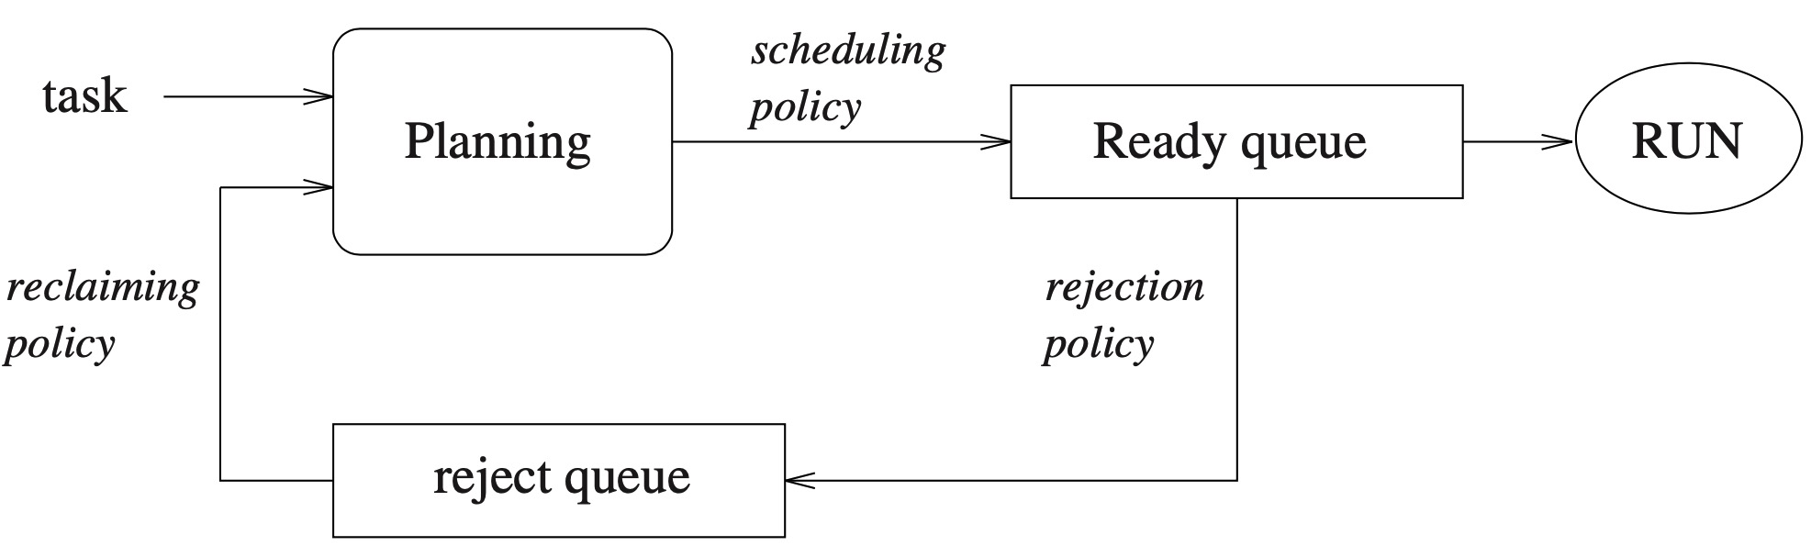
Key Techniques
Acceptance test
On-line validation determines whether hard real-time applications can dynamically create and destroy tasks. The new task can meet the timing constraints while meeting all the hard timing constraints of tasks previously admitted into the system.
Hard Real-Time Computing Systems_ Predictable Scheduling Algorithms and Applications (3rd ed.) [Buttazzo 2011-09-15]

Slide 19
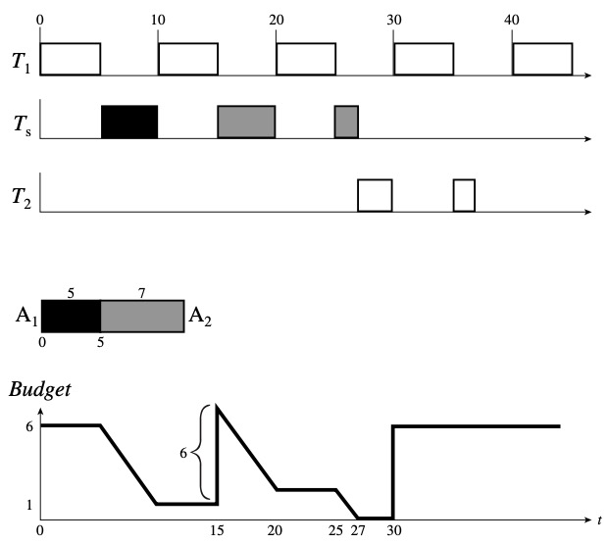
Key Techniques
Bandwidth preserving server
Bandwidth-preserving servers are considered as periodic traffic with predefined priority.
Each type of server is defined by a set of consumption (duration) and replenishment rules (period).
Accepted sporadic packets are queued in the corresponding queue and transmitted according to the GCL.
Example of Fixed-Priority Sporadic ServerT1 = (10, 5), T2 = (59, 5), Ts = (15.6)

Slide 20
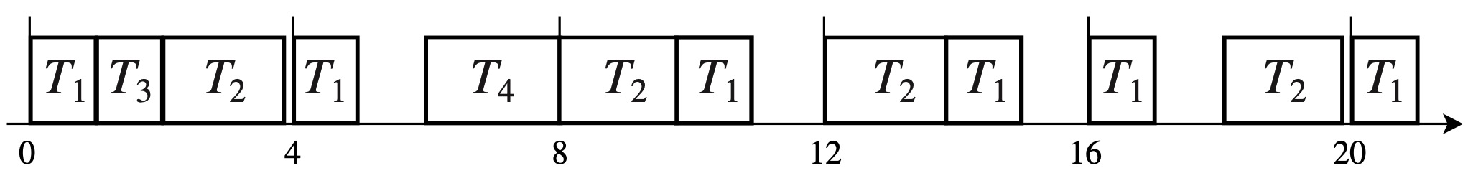
Key Techniques
Scheduling decision time
At any scheduling decision time, interrupt is triggered, and the schedule will compute if there is enough slack space for aperiodic packets transmission. If yes, the aperiodic traffic, which is queued in the rejected queue, can be transmitted.
Decision time points
…..

Slide 21
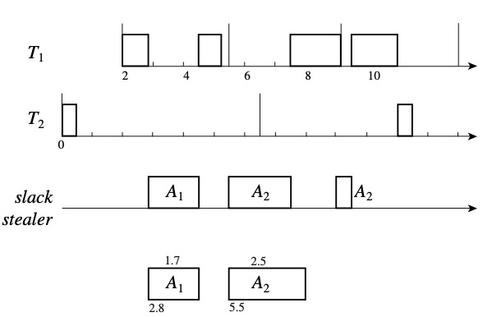
Key Techniques
Decision time points
Slack stealing algorithm
The GCL in the switch is fixed. Therefore, the slack time can be calculated at any scheduling decision time. If it is larger enough, the traffic can be transmitted immediately.
Example illustrating a slack stealer : T1 = (2.0, 3.5, 1.5) and T2 = (6.5, 0.5).

Slide 22
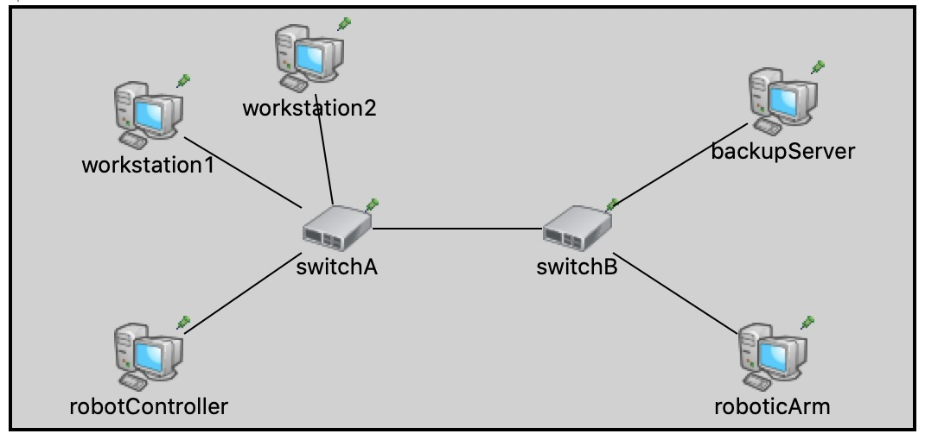
Network Simulation
The simulator is essential to verify our proposed method.
OMNeT++: an extensible, modular, component-based C++ simulation library and framework, primarily for building network simulators.
INET：a comprehensive open-source model library created for OMNeT++.
NeSTiNg Network Simulator for Time-Sensitive Networking (TSN)
In-Vehicle network model
NeSTiNg
Real-time Ethernet
INET-Framework
Internet technologies
OMNeT++
IDE and Simulation kernel
Falk, Jonathan, et al. "NeSTiNg: Simulating IEEE time-sensitive networking (TSN) in OMNeT++." 2019 International Conference on Networked Systems (NetSys). IEEE, 2019.
The existing simulators are based on TSN standards and not suitable for our proposed method.

Slide 23
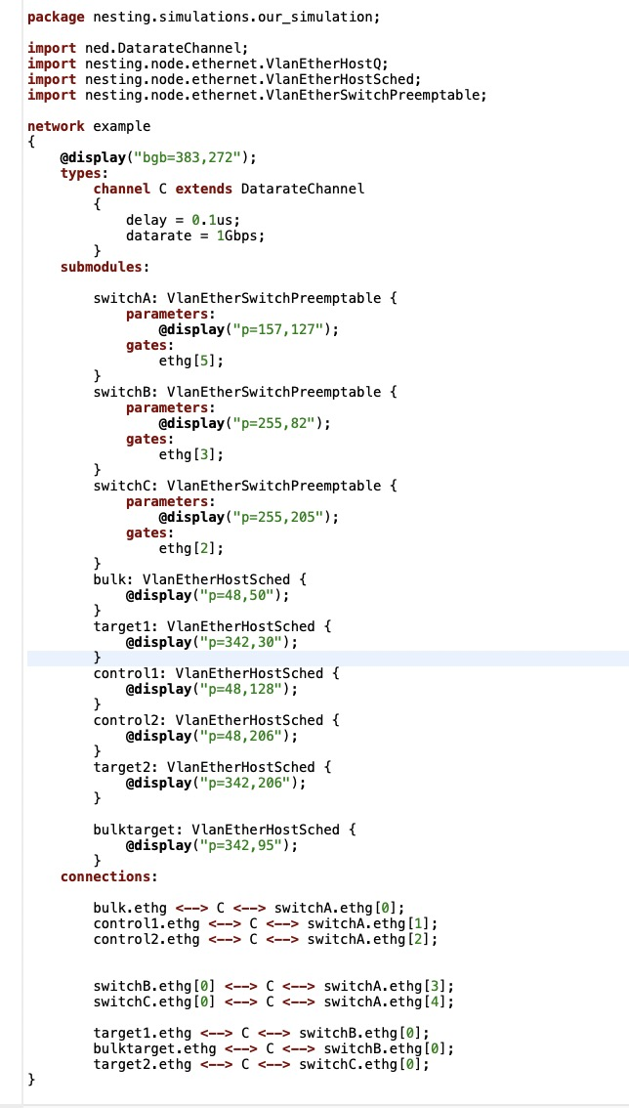
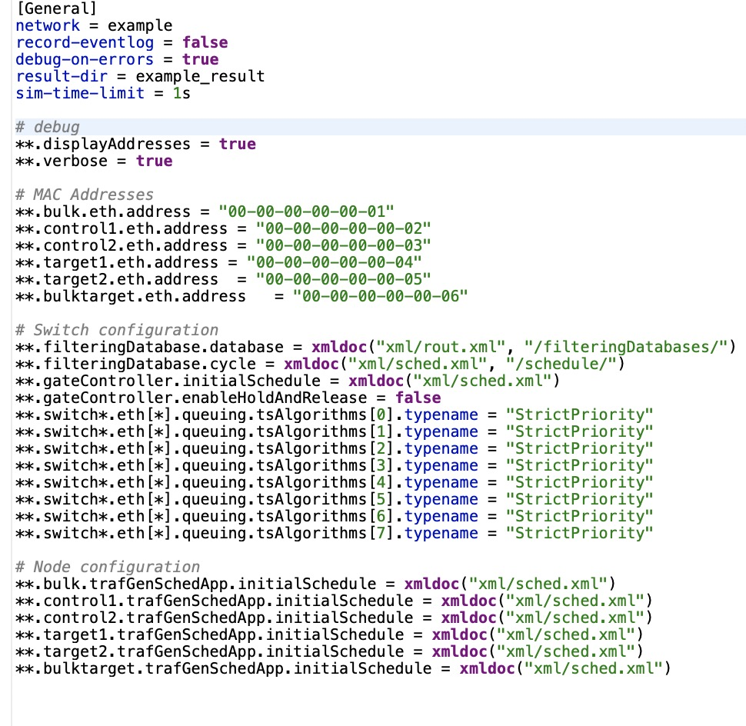
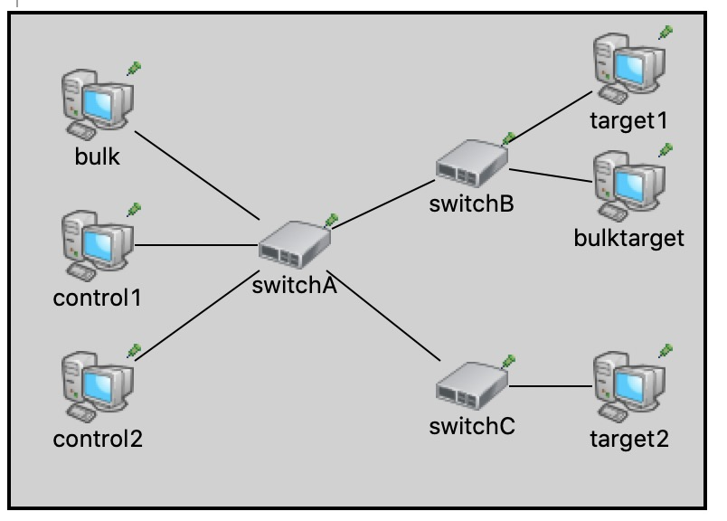
.ini
.ned

Slide 24
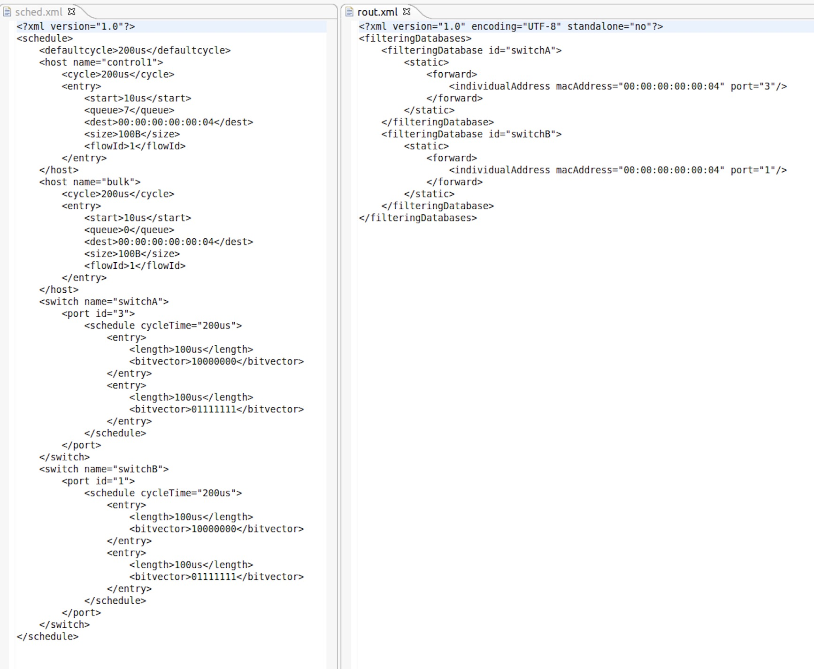
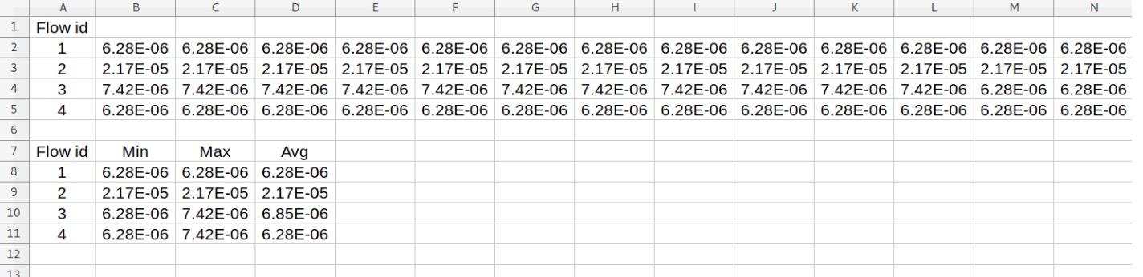
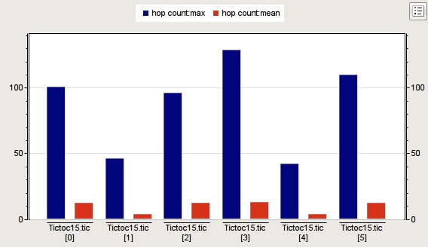
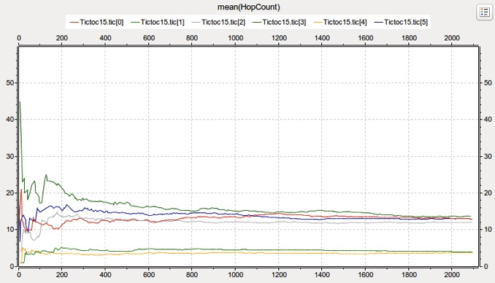

Slide 25
Conclusion
Autonomous vehicles are complex systems. Timing issues are also essential to guarantee safety and reliability.
The automotive industry is currently re-thinking the communication technologies in cars to satisfy the more restrict timing requirements.
Better scheduling methods can guarantee the timing predictability of safety-critical flows of in-vehicle networks. In the meantime, sporadic and aperiodic traffics caused overload can be avoided flexibly.

Slide 26
Thank You!

